Slide 1

Performance Evaluation of Different Machine Learning Models to Predict COVID-19 Cases from Time Series Data.
Submitted as a requirement for CSE 847 Machine Learning term project.
Submitted by:
Redwan Sony (sonymd@msu.edu) MD Alamin (alaminmd@msu.edu)

Slide 2
Project Description
Apply different machine learning prediction models to predict the spread of the COVID-19 cases in near future.
John Hopkins University live data repository dataset
Time series data analysis

Slide 3
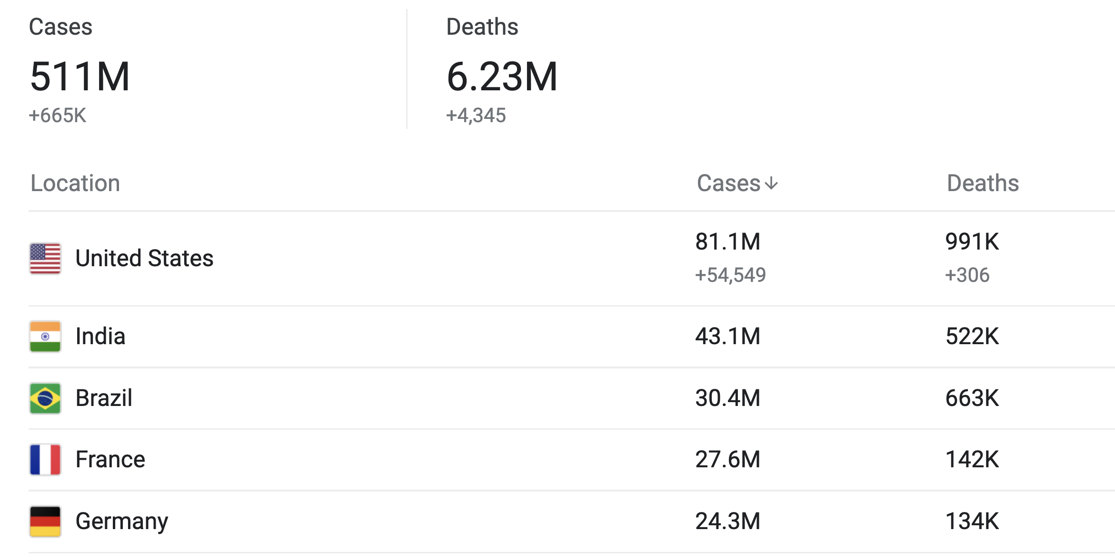
COVID-19 Cases (all)
http://en.wikipedia.org/wiki/Template:COVID-19_pandemic_data

Slide 4
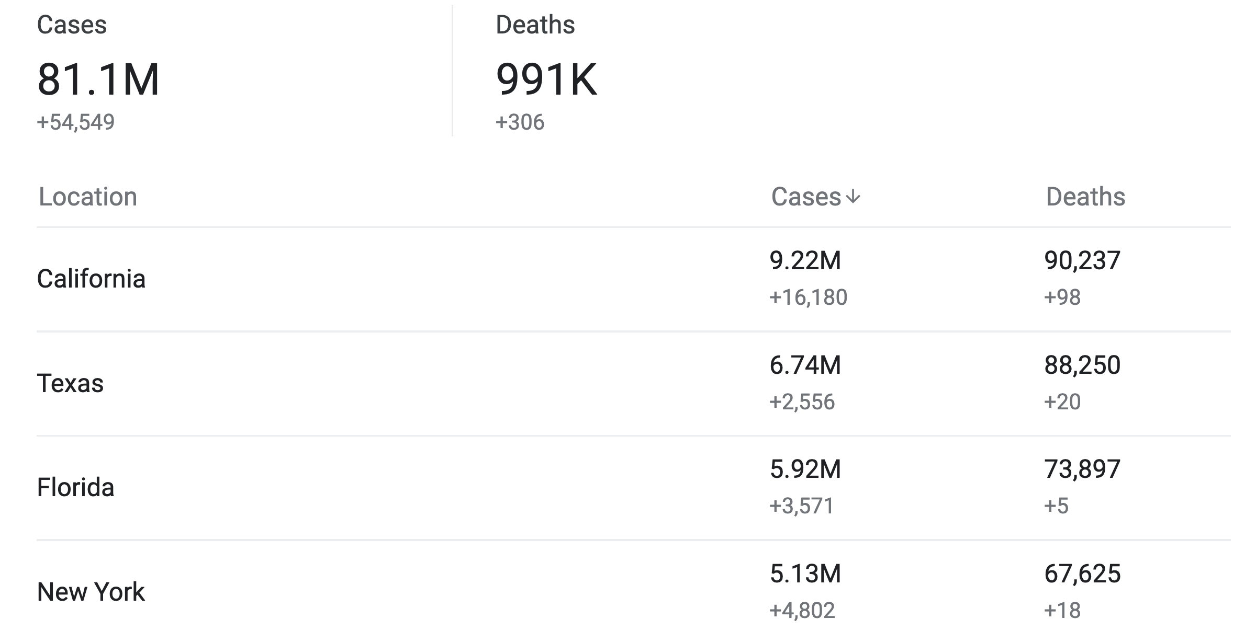
COVID-19 in USA
[1] https://ourworldindata.org/coronavirus-data

Slide 5
Data set description
COVID-19 cases from January 23, 2020 till today
Data from every country.
Data from every state in the USA.
Only few states from the USA is analyzed.

Slide 6

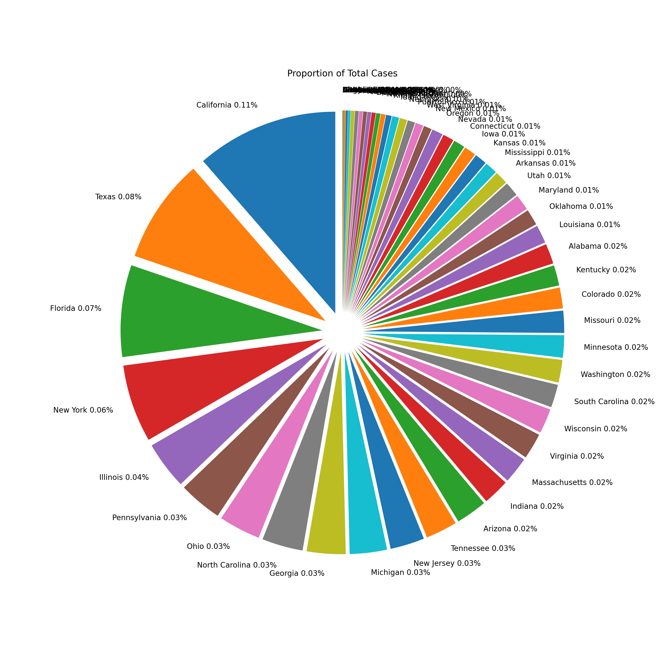
Exploratory Data analsys (EDA)
Maximum Affected State in USA is California (11%)
Texas (0.8%)
Florida (7%)
NewYork(6%)
Illinois (4%)
Michigan (3%)

Slide 7
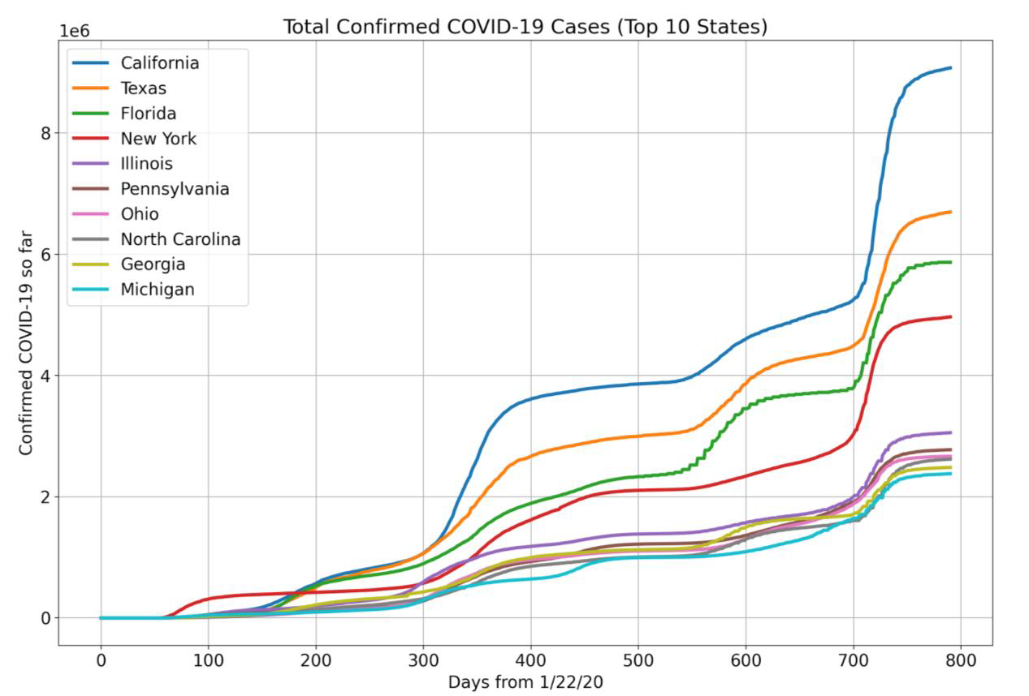
TOP 10 affected states

Slide 8
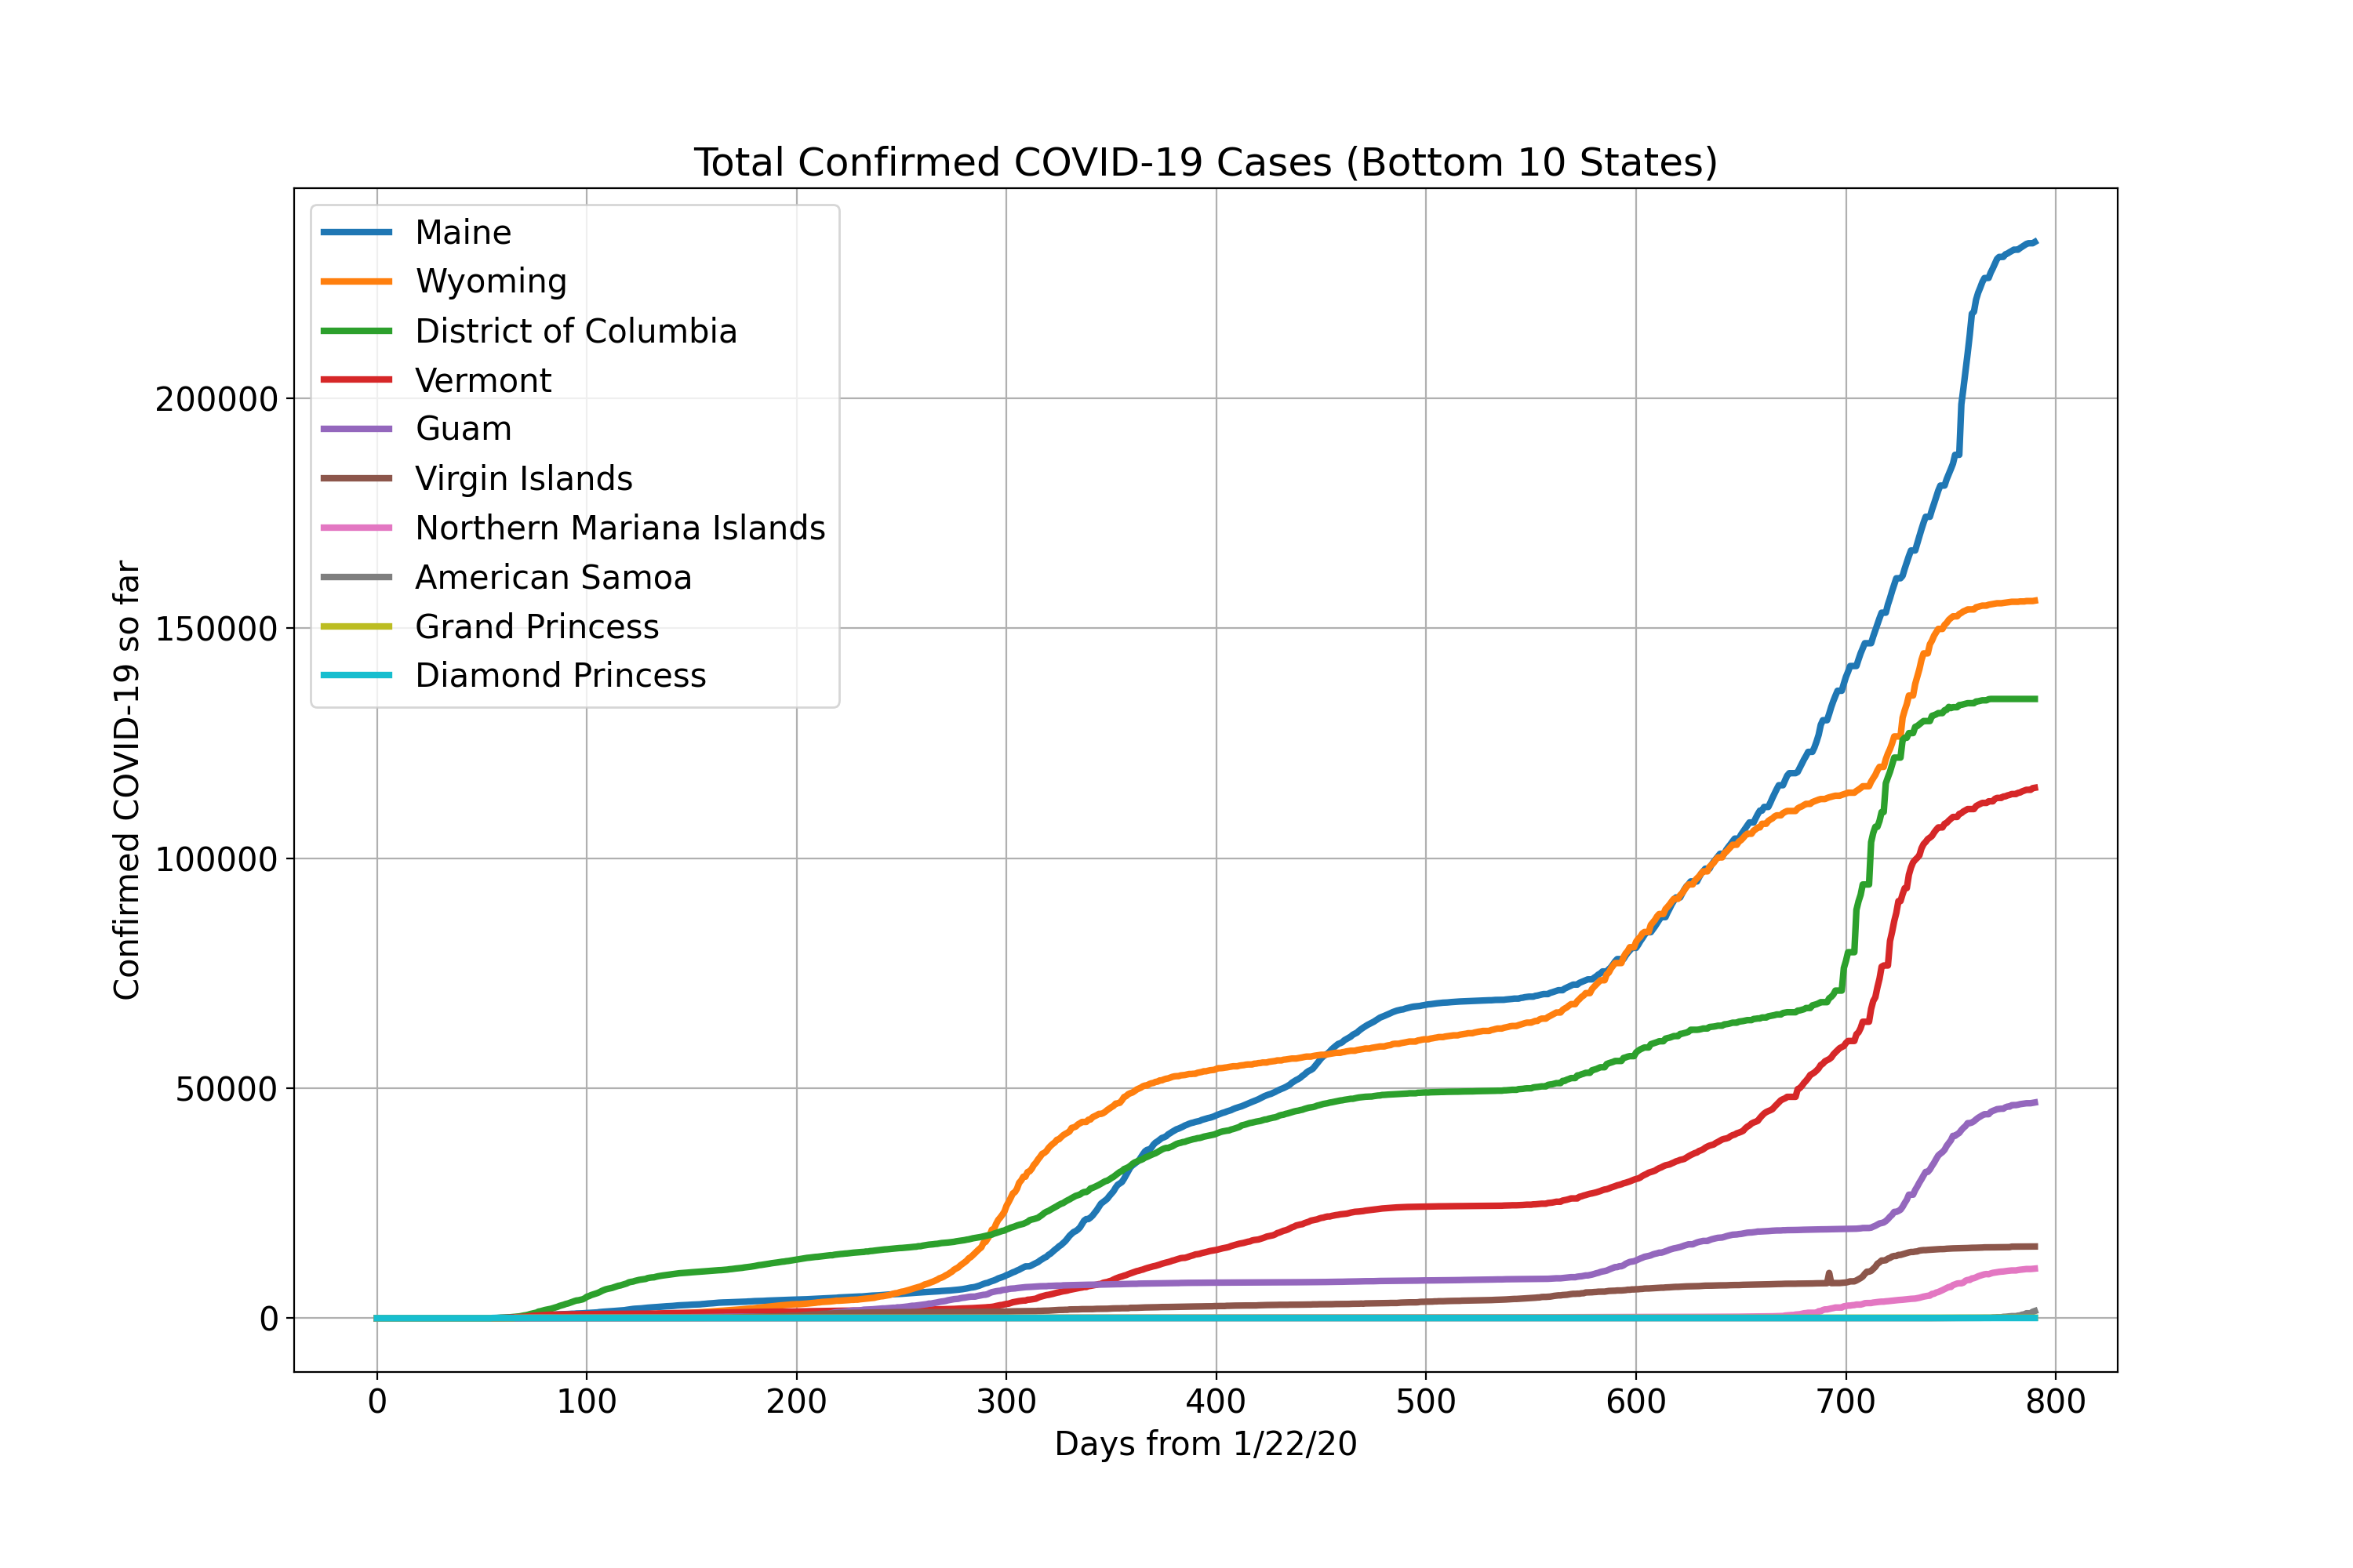
BOTTOM 10 affected states

Slide 9
Machine Learning MODELS USED
Persistence Model
Auto Regressive Model
Regression Model
ARIMA (Auto Regression with Integrated Moving Average) Model

Slide 10
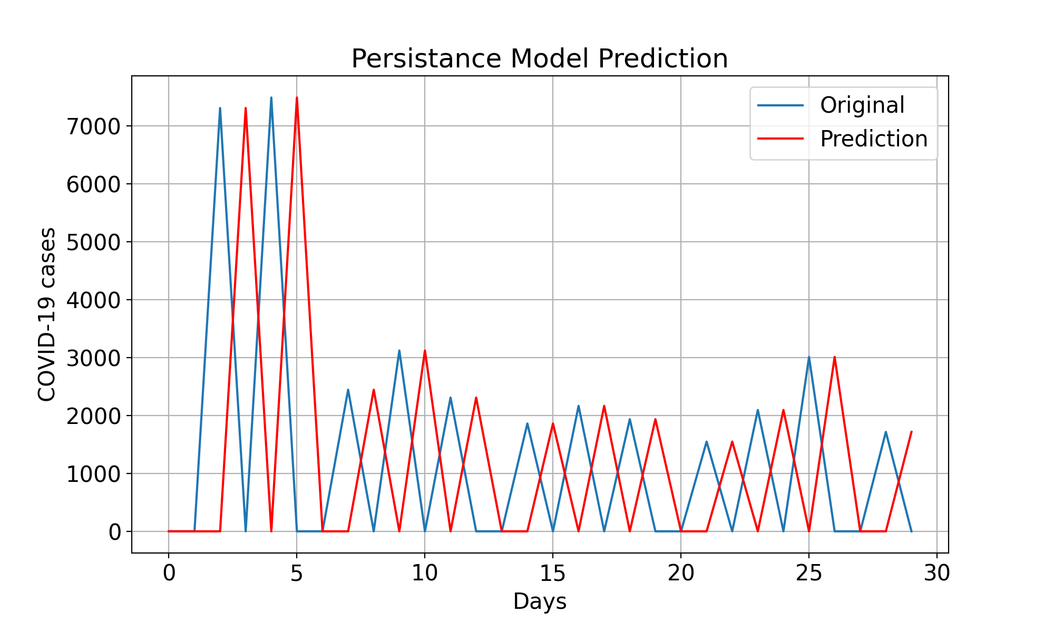
Persistence model
This is the simplest model
The last days observed data is the next day’s predicted value
Predicted version is exactly the one day shifted series.
RMSE value for last 30 day: 3277.620

Slide 11
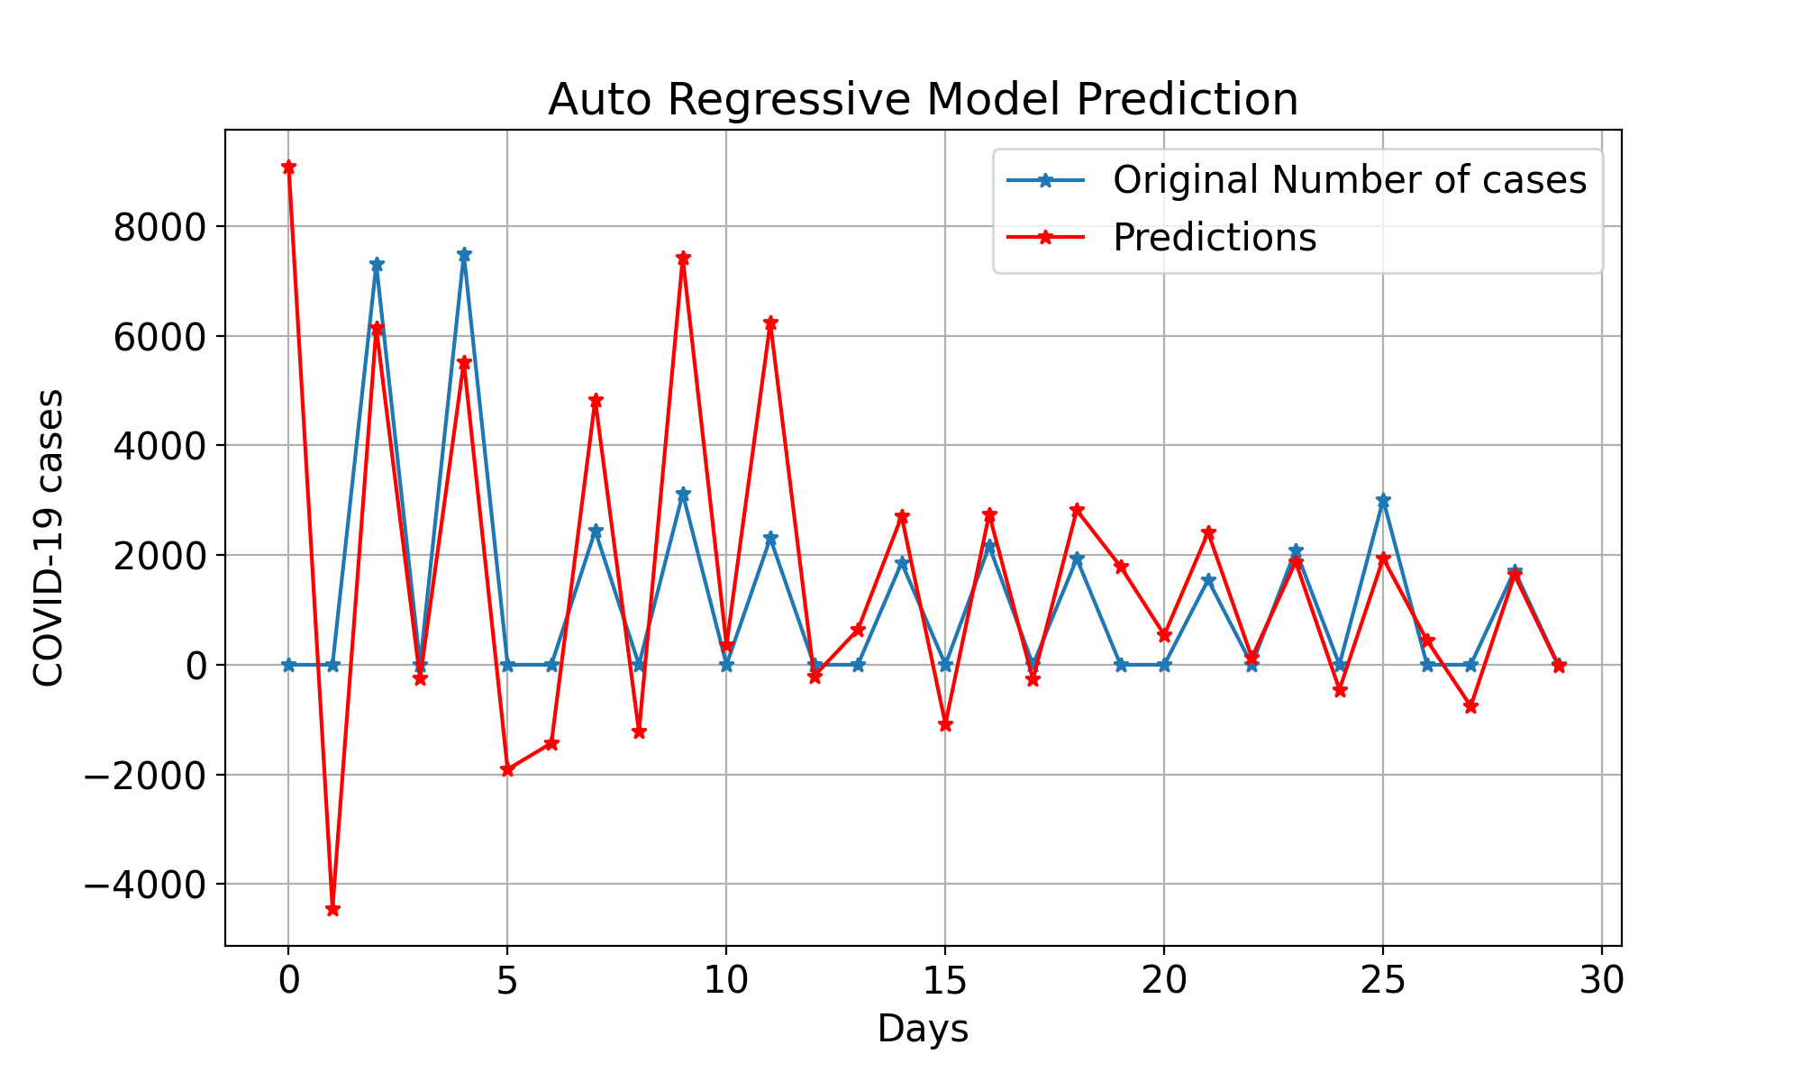
AUTO Regressive model
Autoregression model is a linear regression model that uses lagged variables as input variables.
yhat = b0 + b1*X(t-1) + b2*X(t-2) ... bn*X(t-n+1).
RMSE value for last 30 day: 2341.678

Slide 12
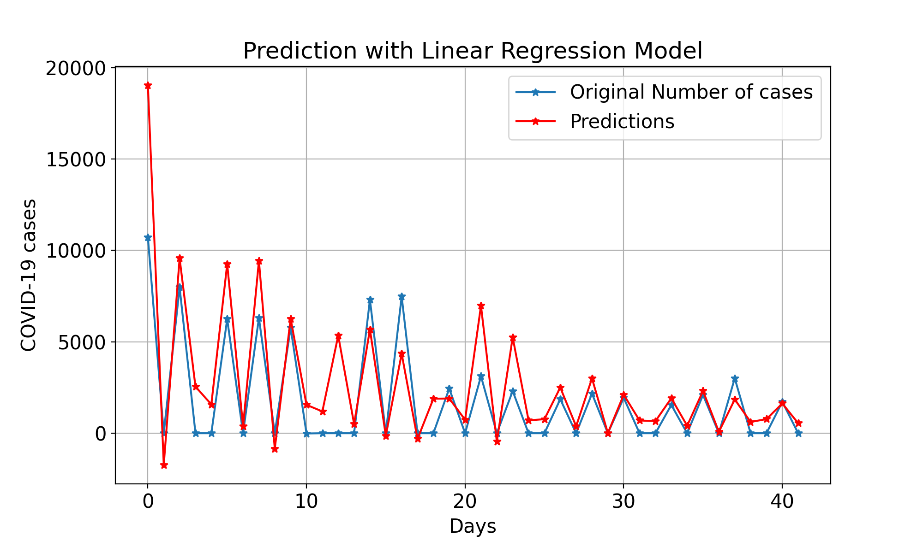
REGRESSION MODEL
Here a lag of seven days is used
For every target value, the last seven days data is used as the training feature vector.
Y_hat = b0 + b1*X(t-1) + b2*X(t-2) ... bn*X(t-6).
RMSE value for last 30 day: 2089.62

Slide 13
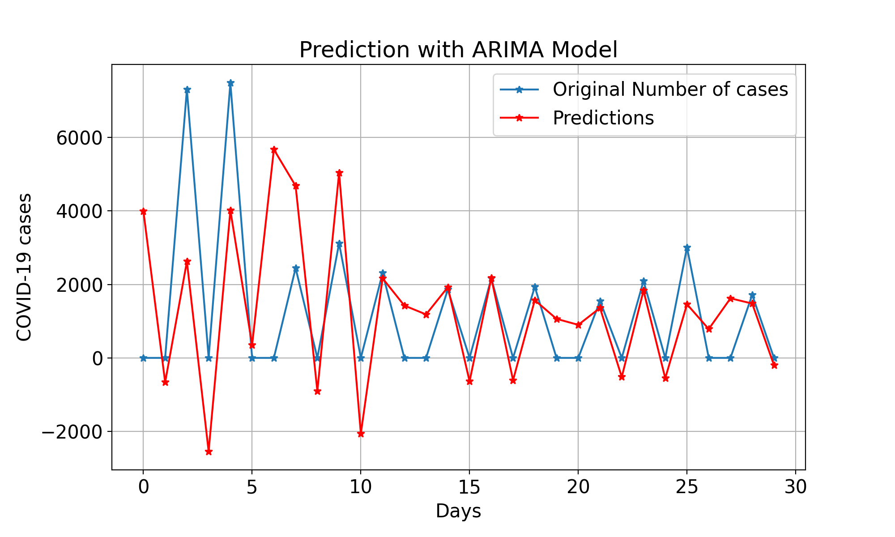
ARIMA Model
AR: Autoregression: uses the dependent relationship between some number of lagged observations and future observation
I: Integrated. The use of differencing of raw in order to make the time series stationary.
MA: Moving Average. A model that uses the dependency between an observation and a residual error from a moving average model applied to lagged observations.
RMSE value for last 30 day: 1963.584

Slide 14
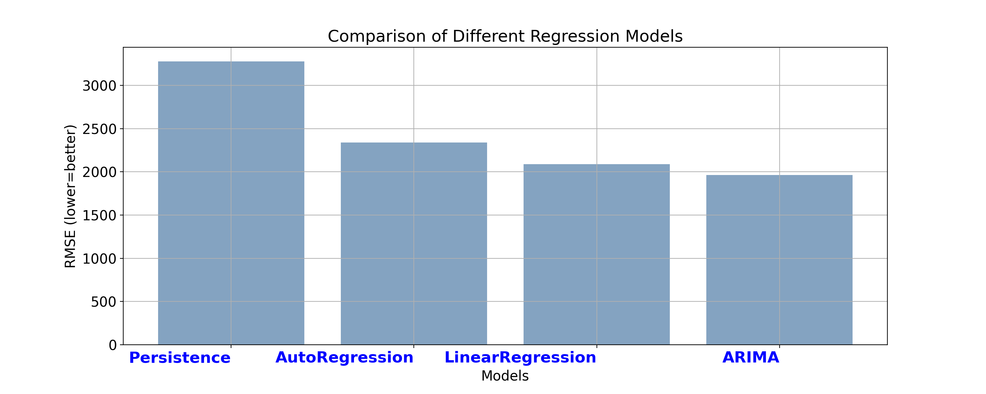
Performance comparison

Slide 15
Future Works
In the Project data in only state of Michigan is used.
States can be clustered in several groups based on the pattern of the daily cases.
Separate models can be trained for different cluster of states with similar COVID-19 cases pattern to predict more accurately.
Impact of different weather attributes can be analyzed to get a better prediction of COVID-19 cases.

